Slide 1
Splitting Rules
Possible splitting functions (rules)
Entropy (Information Gain and Gain Ratio)
Gini Index
Twoing

Slide 2
Information Gain Ratio
The problem with multi-valued and continuous attributes in noisy databases
The probability of a subset of examples to have the same class increases monotonically with a decrease in the subset size
The extreme case is a subset of one example
The average size of a subset decreases with an increase in the total number of attribute values (e.g., attribute Date)
Conclusion
Information gain is biased towards multi-valued and continuous attributes
Notes:
ההסתברות לדגימה שכל הרשומות בה עם אותו סיווג גדלה ככל שגודל הדגימה קטן.
גודל הדגימה הממוצע קטן ככל שיש יותר ערכים אפשריים לתכונה (כשמחלקים את הנתונים לדגימות לפי אותה תכונה).
מסקנה – infoGain מוטה לטובת תכונות בעלות הרבה ערכים אפשריים.

Slide 3
The Gain Ratio Approach
The Gain Ratio Approach
“Punish” the multi-valued attributes via dividing (normalizing) their information gain by the Split Information:
The Split Information represents the entropy of the tested attribute (in contrast to the entropy of the target attribute)
The Gain Ratio: Gain(A)/SplitInfo(A)

Slide 4
The Gain Ratio Approach - Example
Notes:
IV = intrinsic value = SplitInfo

Slide 5
The Gain Ratio Approach - Example
Notes:
IV = intrinsic value = SplitInfo

Slide 6
The Gain Ratio Approach - Example
Info(Decision) = Info(1,2,3) =
-1/6log₂1/6 -2/6log₂2/6 -3/6log₂3/6 = 1.46
Info_{Temperature}(Decision) = 1/6*0 + 2/6*1 + 1/6*0 +1/6*0 + 1/6*0 = 0.33
Gain(Temperature) = 1.46-0.33 = 1.13
The Gain Ratio: Gain(A) / IV(A)
Gain Ratio (Temperature) = 1.13/2.25 = 0.502

Slide 7
The Gain Ratio Approach - Example
Info_{Humidity}(Decision) = 2/6*0 + 1/6*0 + 2/6*0 +1/6*0 = 0
Gain(Humidity) = 1.46-0 = 1.46
Gain Ratio (Humidity) = 1.46/1.92 = 0.76
0.76 > 0.502 → We’ll prefer the Humidity attribute.

Slide 8
The Gain Ratio Split
Record | Attribute | Class
1 | 1 | 0
2 | 1.5 | 1
3 | 1.5 | 0
4 | 1.7 | 1
5 | 2.1 | 1

Slide 9
The Gain Ratio Split
Record | Attribute | Class
1 | 1 | 0
2 | 1.5 | 1
3 | 1.5 | 0
4 | 1.7 | 1
5 | 2.1 | 1
_{Classes}
N(L,R) | 0 |  | 1 |  | Total
 | L | R | L | R | L | R
1 | 1 | 1 | 0 | 3 | 1 | 4
1.5 | 2 | 0 | 1 | 2 | 3 | 2
1.7 | 2 | 0 | 2 | 1 | 4 | 1
2.1 | 2 | 0 | 3 | 0 | 5 | 0

Slide 10
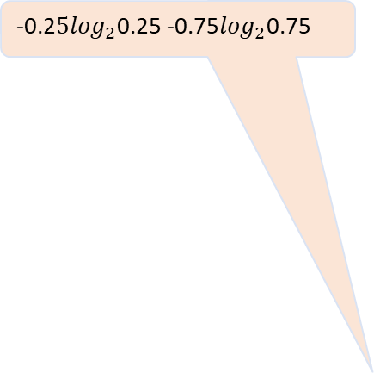

The Gain Ratio Split
0.971-(1/5)*0-(4/5)*0.81=0.32
-0.2$5\log_{2}$0.25 -0.75$\log_{2}$0.75
-0.67$\log_{2}$0.67 -0.33$\log_{2}$0.33
0.971-(3/5)*0.92-(2/5)*0
P(L,R)+ | 0 |  | 1 |  | Entropy |  | Gain | G.R.
 | L | R | L | R | L | R
1 (1,4) | 1 | =(1/4) =0.25 | 0 | 0.75 | 0 | 0.81 | 0.32 | 0.17
1.5 (3,2) | 0.67 | 0 | 0.33 | 1 | 0.92 | 0 | 0.42 | 0.22
1.7 (4,1) | 0.5 | 0 | =(2/4) =0.5 | 1 | 1 | 0 | 0.17 | 0.09
2.1 (5,0) | 0.4 | 0 | 0.6 | 0 | 0.97 | 0 | 0 | 0
0.17/1.92

Slide 11
Gini Index
All attributes are assumed continuous valued
Assume there exist several possible split values for each attribute
May need other tools, such as clustering, to get the possible split values
Can be modified for categorical attributes

Slide 12
Gini Index
If a data set T contains examples from n classes, gini index, gini(T) is defined as:
where p_{j} is the relative frequency of class j in T.
If a data set T is split into two subsets T₁ and T₂ with sizes N₁ and N₂ respectively, the gini index of the split data contains examples from n classes, the gini index gini(T) is defined as:
The attribute provides the smallest gini_{split}(T) is chosen to split the node (need to enumerate all possible splitting points for each attribute).
Reduction in Impurity:

Slide 13
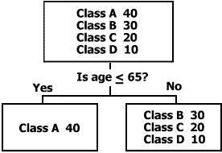
Gini Index
Looks for the largest class in the data set and strives to isolate it from all other classes

Slide 14
Gini Index - Example
Record | Attribute | Class
1 | 1 | 0
2 | 1.5 | 1
3 | 1.5 | 0
4 | 1.7 | 1
5 | 2.1 | 1

Slide 15
Gini Index - Example
Record | Attribute | Class
1 | 1 | 0
2 | 1.5 | 1
3 | 1.5 | 0
4 | 1.7 | 1
5 | 2.1 | 1
_{Classes}
N(L,R) | 0 |  | 1 |  | Total
 | L | R | L | R | L | R
1 | 1 | 1 | 0 | 3 | 1 | 4
1.5 | 2 | 0 | 1 | 2 | 3 | 2
1.7 | 2 | 0 | 2 | 1 | 4 | 1
2.1 | 2 | 0 | 3 | 0 | 5 | 0

Slide 16
1-((1/4)²+(3/4)²)
P(L,R)+ | 0 |  | 1 |  | Gini(A) |  | Gini Split
 | L | R | L | R | L | R
1 (1,4) | =1/1 | 1/4 | =0/1 | =3/4 | 0 | 0.38 | 0.3
1.5 (3,2) | 0.67 | 0 | 0.33 | 1 | 0.44 | 0 | 0.27
1.7 (4,1) | 0.5 | 0 | =2/4 | 1 | 0.5 | 0 | 0.4
2.1 (5,0) | =2/5 | 0 | =3/5=0.6 | 0 | 0.48 | 1 | 0.48
1-(2/5)²+(3/5)²)
((3/5)*0.44+(2/5)*0)

Slide 17
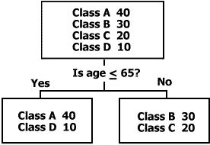
Twoing
Attempts to find groups of up to 50% of the data each

Slide 18
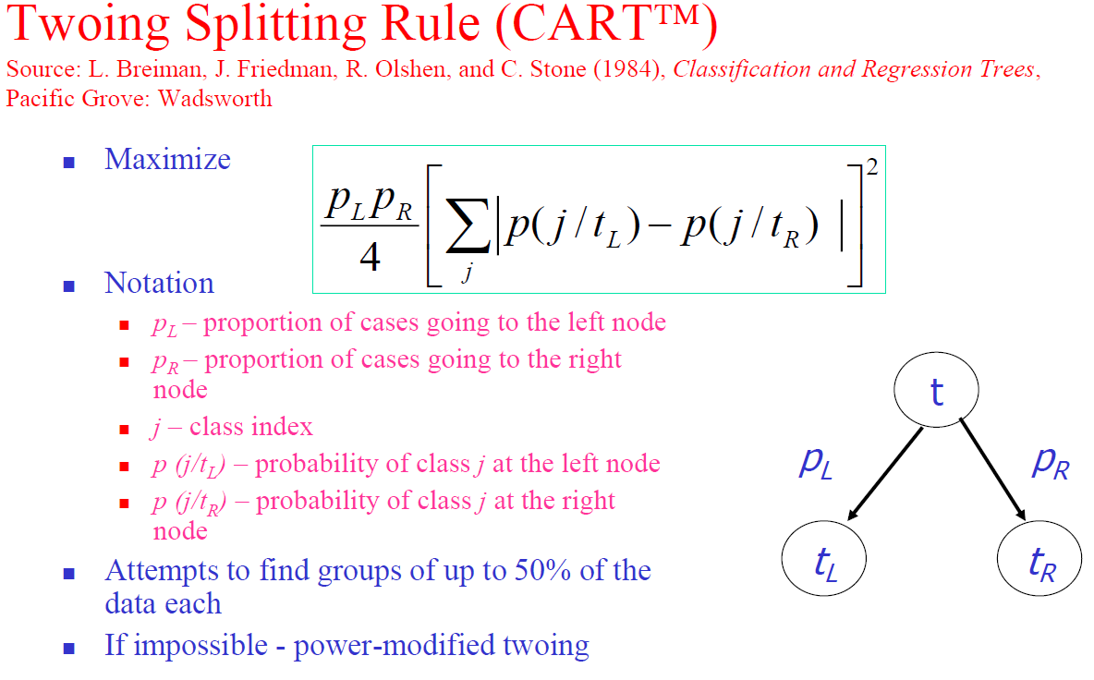
Twoing

Slide 19
Twoing Split Rule- Example
Record | Attribute | Class
1 | 1 | 0
2 | 1.5 | 1
3 | 1.5 | 0
4 | 1.7 | 1
5 | 2.1 | 1

Slide 20
The Twoing Split Example
=|1-0.25|
P(L,R)+ | 0 |  | 1 |  | |PL-PR| |  | Total | Twoing
 | L | R | L | R | 0 | 1
1 (1,4) | 1 | 0.25 | 0 | 0.75 | 0.75 | 0.75 | 1.5 | 0.09
1.5 (3,2) | 0.67 | 0 | 0.33 | 1 | 0.67 | 0.67 | 1.33 | 0.107
1.7 (4,1) | 0.5 | 0 | 0.50 | 1 | 0.5 | 0.5 | 1 | 0.04
2.1 (5,0) | 0.4 | 0 | 0.60 | 0 | 0.4 | 0.6 | 1 | 0

Slide 21
Using Splitting Rules (Gini, Twoing, Entropy)
Gini – is usually best for yes / no outcomes.
Twoing – similar to entropy but more flexible because it has a tuning parameter.
Excellent for multi-class outcomes
Twoing is excellent for hard to classify problems
problems where accuracy for all methods will be low
inherently difficult problems or low signal/noise ratio
Entropy popular in Machine Learning literature

